Slide 1

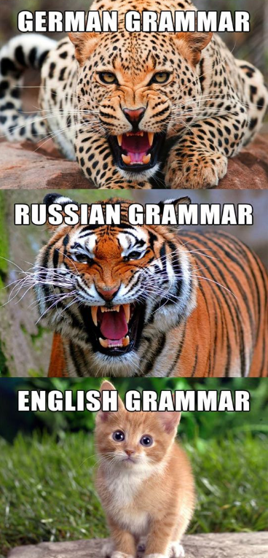

PyData Berlin Meetup March 15th, 2017 Grégory Vial - ds@gregvi.al
Requirements:
Develop a hand-written text recognition engine
Build a version of MNIST for cyrillic & latin
Objective: Develop an app to teach Russian

Slide 2

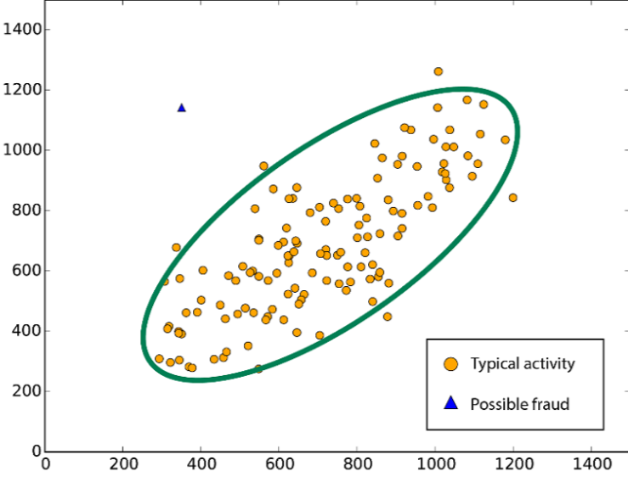

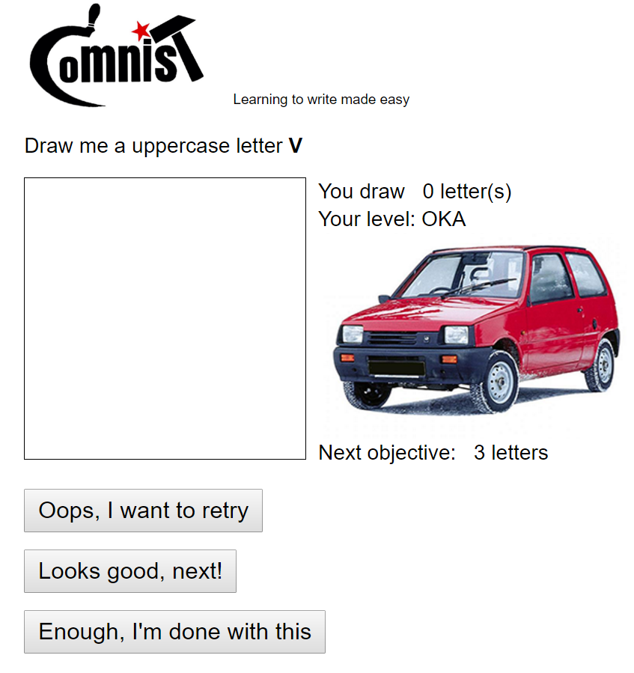

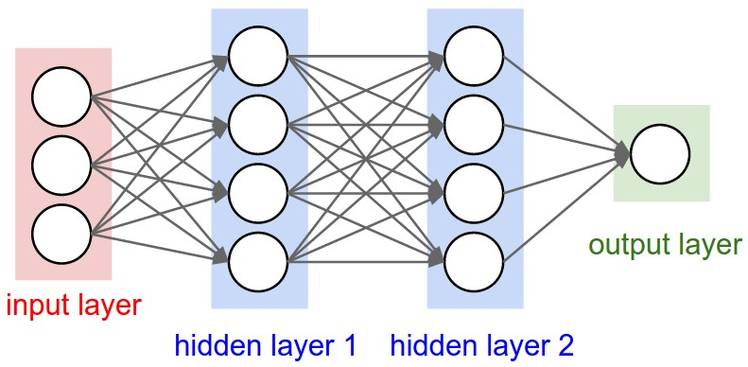
Cyrillic-oriented MNIST
Usual
GitHub repository
50k+ images
Creative commons
Unusual
Anomaly detection
Web page w/ gamification
Docker service on the cloud
Conv. Neural network

Slide 3
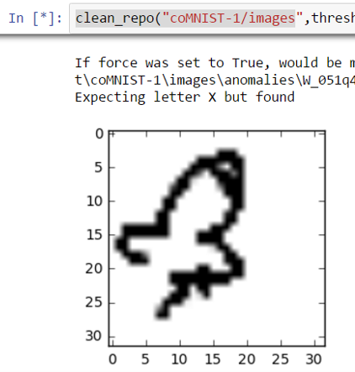
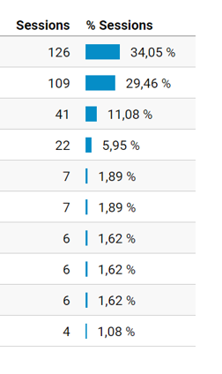
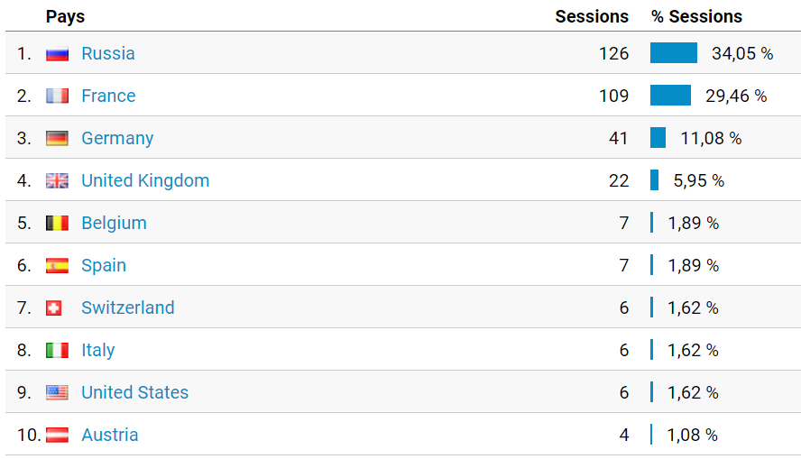



Cyrillic-oriented MNIST
After one week
370 participants
31 countries
18k letters collected
Top 10 countries
Record: 699 letters for a single user
Some anomalies flagged

Slide 4
Cyrillic-oriented MNIST
How can you help?
Help me build the dataset by drawing letters:
Latin: http://comnist.gregvi.al
Cyrillic :http://comnist.gregvi.al/?ru
Share these pages around you, ask your friends, kids, spouse, dog etc to participate
Find out more on https://github.com/GregVial/CoMNIST

